Slide 1












Invitation Collection
Directions: Edit any of the invitation templates below to invite families to special events in your classroom or school. Customize each one to fit the needs of your class / campus.
Instructions:
Edit or modify any slide
Print as full page slides or Select: 2 slides per page for smaller invitations, ready to print & cut out!
Or
print as a PDF to create an e-Invitation, ready to email.
©Model Teaching, 2021. All Rights Reserved.

Slide 2
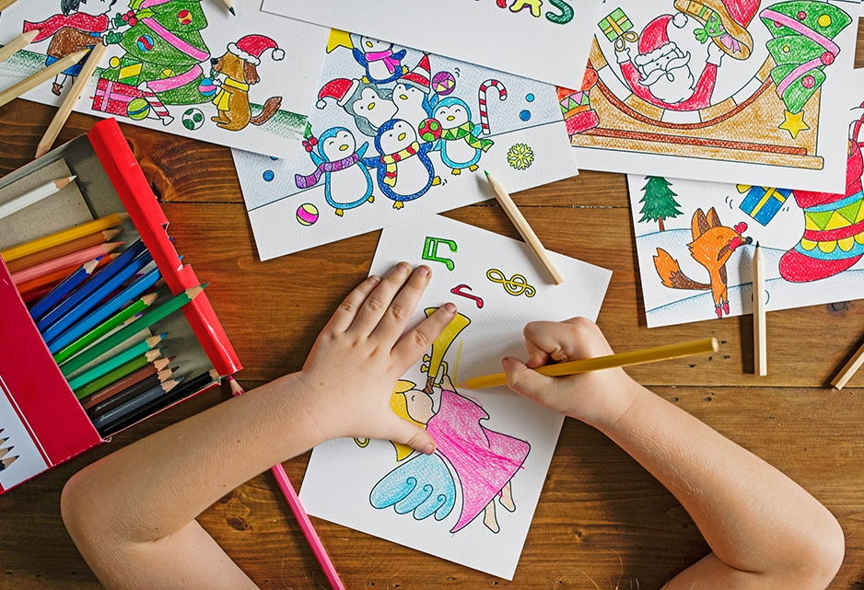
Tears and Cheers

Slide 3

Donuts with Dad!
Please join us from ____________ to _____________
Date:
Location:
Free donuts, juice, and coffee will be provided!
*Bring a camera for a special photo of you and your child!

Slide 4
Family Fitness Night
Date / Time:
Location:
Free Fun for the Entire Family!
Join your teachers, classmates, and parents for some healthy fun!

Slide 5


DATE / TIME:
FRIDAY MOVIE NIGHT
Location:
Families are invited to join us for a showing of:
Free popcorn and pizza for all!
*This is not a drop-off event. Parents must stay with their child.*

Slide 6



Spotlight Night
_________ are in the SPOTLIGHT!
Join us to see the fine work our ___________ have done this year!
Date / Time:
Location:
This is a family friendly event for everyone!

Slide 7
Curriculum Night!
Learn what your child will be learning this year!
Date / Time:
Location:
* Childcare provided for students and younger siblings in the gym. *

Slide 8
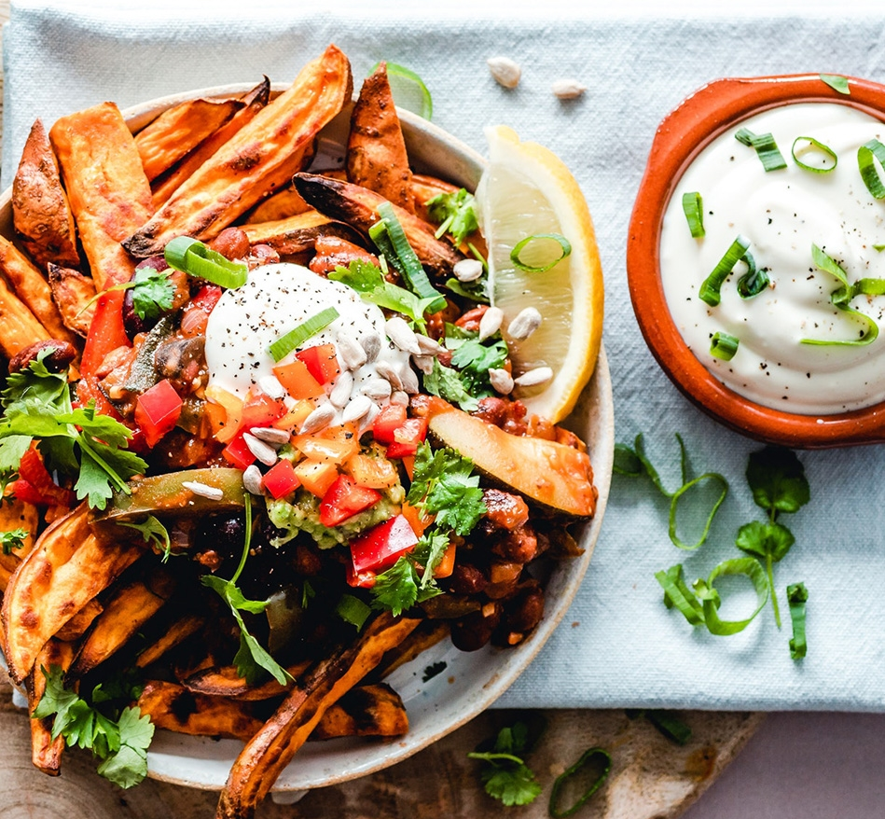

Grandparents Day Lunch!
Join your grandchild for lunch!
Date / Time:
Location:
Bring in a special lunch, or buy in the cafeteria

Slide 9






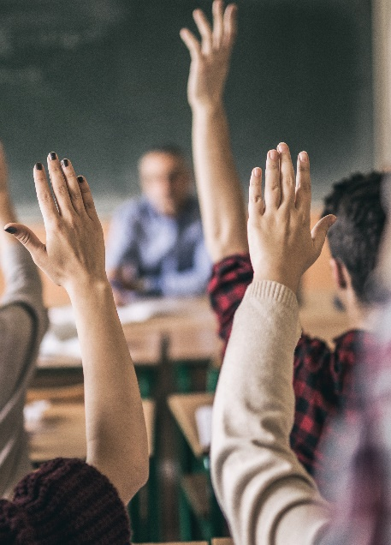

Project Presentation
DATE/TIME:
LOCATION:
Students have been hard at work on their____ projects. Come view these projects to learn more about _____.

Slide 10

Student Author Read-Aloud
Date /Time:
Location:
Families are invited to join us for a read-aloud of our best work!
Listen to each student author share their favorite writing piece.
Notes:
NOTE:
To change the image on this slide, select the picture and delete it. Then click the Pictures icon in the placeholder to insert your own image.

Slide 11


Muffins With Mom!
Please join us from ____________ to _____________
Date:
Location:
Free muffins, juice, and coffee will be provided!
*Bring a camera for a special photo of you and your child!

Slide 12

Flashlight Read-In
Join us in celebrating literacy with a flashlight read-in
Bring a flashlight and book to share!
Date/Time:
Location:

